Slide 1
Seminar on Big Data Wed., 20th July 2016
Dr. Girish Tere,
Asst. Professor, Department of Computer Science,
Thakur College of Science and Commerce,
Mumbai

Slide 2
Outline
Why Big Data?
Terminology
Key Technologies: Google File System, MapReduce,
Hadoop
Hadoop and other database tools
Types of Databases
Bibliography

Slide 3
What is Big Data?
What is data?
The quantities, characters, or symbols on which operations are performed by a computer, which may be stored and transmitted in the form of electrical signals and recorded on magnetic, optical, or mechanical recording media.” –Oxford Dictionary
Big Data is also a data!

Slide 4


Examples Of Big Data
The New York Stock Exchange generates about one terabyte of new trade data per day.
Social Media Impact
Statistic shows that 500+terabytes of new data gets ingested into the databases of social media site Facebook, every day. This data is mainly generated in terms of photo and video uploads, message exchanges, putting comments etc.

Slide 5

Examples Of Big Data…
Single Jet engine can generate 10+terabytes of data in 30 minutes of a flight time. With many thousand flights per day, generation of data reaches up to many Petabytes.

Slide 6
Categories Of Big Data
Structured
Un-structured
Semi-structured

Slide 7
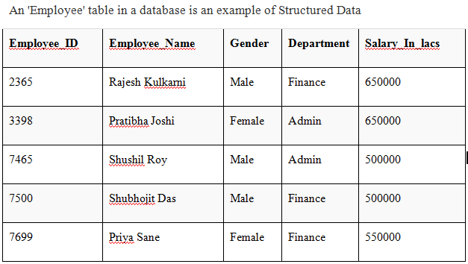
Examples Of Structured Data

Slide 8
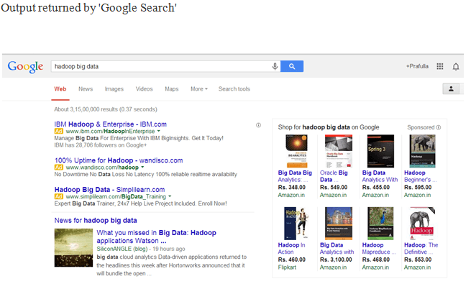
Examples Of Un-structured Data

Slide 9
Examples Of Semi-structured Data
Personal data stored in a XML file-
<rec><name>Prashant Rao</name><sex>Male</sex><age>35</age></rec>
<rec><name>Seema Joshi</name><sex>Female</sex><age>41</age></rec>
<rec><name>Satish Mane</name><sex>Male</sex><age>29</age></rec>
<rec><name>Subrato Roy</name><sex>Male</sex><age>26</age></rec>
<rec><name>John</name><sex>Male</sex><age>35</age></rec>

Slide 10
Big Data Fundamentals
Data is measured by 3V's:
Volume: TB
Velocity: TB/sec. Speed of creation or change
Variety: Type
(Text, audio, video, images, geospatial, ...)
Increasing processing power, storage capacity, and networking have caused data to grow in all 3 dimensions.
Volume, Location, Velocity, Churn, Variety, Veracity (accuracy, correctness, applicability)
Customer Churn: A Key Performance Indicator for Banks
Examples: social network data, sensor networks,
Internet Search, Genomics, astronomy, …

Slide 11
Why Big Data now?
Low cost storage to store data that was discarded earlier
Powerful multi-core processors
Low latency possible by distributed computing: Compute
clusters and grids connected via high-speed networks
Virtualization -> Partition, Aggregate, isolate resources in any size and dynamically change it -> Minimize latency for any scale
Affordable storage and computing with minimal man power via clouds - > Possible because of advances in Networking

Slide 12
Why Big Data now?...
Better understanding of task distribution (MapReduce),
computing architecture (Hadoop),
Advanced analytical techniques (Machine learning)
Managed Big Data Platforms: Cloud service providers, such
as Amazon Web Services provide Elastic MapReduce, Simple
storage Service (S3) and HBase – column oriented database.
Google’ BigQuery and Prediction API.
Open-source software: OpenStack, PostGresSQL
March 12, 2012: President Obama announced $200M for Big Data research. Distributed via NSF, NIH, DOE, DoD, DARPA, and USGS (Geological Survey)
http://www.cccblog.org/2016/05/04/big-data-government-funding-opportunities/

Slide 13
Advantages Of Big Data Processing
Businesses can utilize outside intelligence while taking decisions
Improved customer service
Early identification of risk to the product / services, if any
Better operational efficiency

Slide 14
Big Data Applications
Monitor premature infants to alert when interventions is needed
Predict machine failures in manufacturing
Prevent traffic jams, save fuel, reduce pollution

Slide 15
ACID requirements
Atomicity: All or nothing. If anything fails, entire transaction
fails. Example, Payment and ticketing.
Consistency: If there is error in input, the output will not be
written to the database. Database goes from one valid state to
another valid states. Valid=Does not violate any defined rules.
Isolation: Multiple parallel transactions will not interfere with
each other.
Durability: After the output is written to the database, it stays
there forever even after power loss, crashes, or errors.
Relational databases provide ACID while non-relational databases aim for BASE (Basically Available, Soft, and Eventual Consistency)

Slide 16
Terminology
Structured Data: Data that has a pre-set format, e.g., Address
Books, product catalogs, banking transactions,
Unstructured Data: Data that has no pre-set format. Movies,
Audio, text files, web pages, computer programs, social media,
Semi-Structured Data: Unstructured data that can be put into
a structure by available format descriptions
80% of data is unstructured.
Batch vs. Streaming Data
Real-Time Data: Streaming data that needs to analyzed as it
comes in. E.g., Intrusion detection. Aka “Data in Motion”
Data at Rest: Non-real time. E.g., Sales analysis.
Metadata: Definitions, mappings, scheme

Slide 17

Relational Databases and SQL
Relational Database: Stores data in tables. A “Schema”
defines the tables, the fields in tables and relationships between the two. Data is stored one column/attribute
SQL: Most commonly used language for creating, retrieving, updating, and deleting (CRUD) data in a relational database
Example: To find the gender of customers who bought XYZ:
Select CustomerID, State, Gender, ProductID from “Customer
Table”, “Order Table” where ProductID = XYZ

Slide 18
Non-relational Databases
NoSQL: Not Only SQL. Any database that uses non-SQL
interfaces, e.g., Python, Ruby, C, etc. for retrieval.
Typically store data in key-value pairs.
Not limited to rows or columns. Data structure and query is
specific to the data type
High-performance in-memory databases
RESTful (Representational State Transfer) web-like APIs
Eventual consistency: BASE in place of ACID

Slide 19
NewSQL Databases
Overcome scaling limits of MySQL
Same scalable performance as NoSQL but using SQL
Providing ACID
Also called Scale-out SQL
Generally use distributed processing.

Slide 20
Columnar Databases
id | Name | Salary
101 | Sanjay | 10000
105 | Jatin | 20000
106 | Milind | 15000
In Relational databases, data in each row of the table is stored together: 001:101,Sanjay,10000; 002:105,Jatin,20000; 003:106,Milind;15000
Easy to find all information about a person.
Difficult to answer queries about the aggregate:
How many people have salary between 12k-15k?
In Columnar databases, data in each column is stored together.
101:001,105:002,106:003; Sanjay:001, Jatin:002,Milind:003;
10000:001, 20000:002, 150000:003
Easy to get column statistics
Very easy to add columns
Good for data with high variety -> simply add columns

Slide 21
Types of Databases
Relational Databases: PostgreSQL, SQLite, MySQL
NewSQL Databases: Scale-out using distributed processing
Non-relational Databases:
Key-Value Pair (KVP) Databases: Data is stored as Key:Value, e.g., Riak Key-Value Database
Document Databases: Store documents or web pages, e.g., MongoDB, CouchDB
Columnar Databases: Store data in columns, e.g., HBase
Graph Databases: Stores nodes and relationship, e.g., Neo4J
Spatial Databases: For map and navigational data, e.g., OpenGEO, PortGIS, ArcSDE
In-Memory Database (IMDB): All data in memory. For real time applications
Cloud Databases: Any data that is run in a cloud using IAAS,
VM Image, DAAS

Slide 22
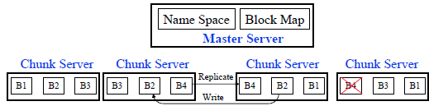
Google File System
Commodity computers serve as “Chunk Servers” and store multiple copies of data blocks
A master server keeps a map of all chunks of files and location of those chunks.
All writes are propagated by the writing chunk server to other chunk servers that have copies.
Master server controls all read-write accesses

Slide 23
Big Table
Distributed storage system built on Google File System
Data stored in rows and columns
Optimized for sparse, persistent, multidimensional sorted map.
Uses commodity servers
Not distributed outside of Google but accessible via Google App Engine

Slide 24
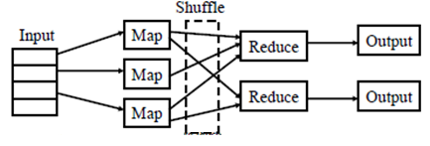
MapReduce
Software framework to process massive amounts of unstructured data in parallel
Goals:
Distributed: over a large number of inexpensive processors
Scalable: expand or contract as needed
Fault tolerant: Continue in spite of some failures
Map: Takes a set of data and converts it into another set of key-value pairs.
(Spilts & Mapping)
Reduce: Takes the output from Map as input and outputs a smaller set of key-value pairs. (Shuffling, Reducing)

Slide 25
MapReduce Example
100 files with daily temperature in two cities. Each file has 10,000 entries.
For example, one file may have (Toronto 20), (New York 30), …
Our goal is to compute the maximum temperature in the two cities.
Assign the task to 100 Map processors each works on one file.
Each processor outputs a list of key-value pairs, e.g., (Toronto
30), New York (65), …
Now we have 100 lists each with two elements. We give this
list to two reducers – one for Toronto and another for New York.
The reducer produce the final answer: (Toronto 55), (New York 65)

Slide 26
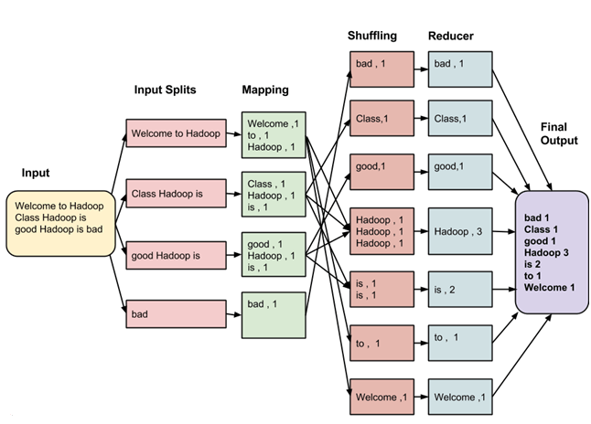
MapReduce Example…
Consider you have following input data for your MapReduce Program
Welcome to Hadoop Class
Hadoop is good
Hadoop is bad

Slide 27
MapReduce Optimization
Scheduling:
Task is broken into pieces that can be computed in parallel
Map tasks are scheduled before the reduce tasks.
If there are more map tasks than processors, map tasks continue until all of them are complete.
A new strategy is used to assign Reduce jobs so that it can be done in parallel
The results are combined.
Synchronization: The map jobs should be comparables so that they finish together. Similarly reduce jobs should be comparable.
Code/Data Collocation: The data for map jobs should be at the processors that are going to map.
Fault/Error Handling: If a processor fails, its task needs to be assigned to another processor.

Slide 28
Hadoop story…
Doug Cutting at Yahoo and Mike Caferella were working on creating a project called “Nutch” for large web index.
They saw Google papers on MapReduce and Google File System and used it
Hadoop was the name of a yellow plus elephant toy that Doug’s son had.
In 2008 Amr Awadallah left Yahoo to found Cloudera.
In 2009 Doug joined Cloudera.

Slide 29

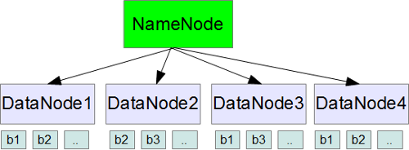
Hadoop
Apache HADOOP is a framework used to develop data processing applications which are executed in a distributed computing environment.
An open source implementation of MapReduce framework
Three components:
Hadoop Common Package (files needed to start Hadoop)
Hadoop Distributed File System: HDFS
MapReduce Engine
HDFS requires data to be broken into blocks. Each block is stored on 2 or more data nodes on different racks.
Name node: Manages the file system name space
-> keeps track of where each block is.

Slide 30
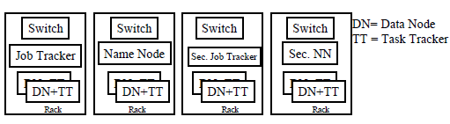
Hadoop…
Data node: Constantly ask the job tracker if there is something for them to do
Used to track which data nodes are up or down
Job tracker: Assigns the map job to task tracker nodes that have the data or are close to the data (same rack)
Task Tracker: Keep the work as close to the data as possible.

Slide 31
Hadoop…
Data nodes get the data if necessary, do the map function, and write the results to disks.
Job tracker than assigns the reduce jobs to data nodes that have the map output or close to it.
All data has a check attached to it to verify its integrity.

Slide 32
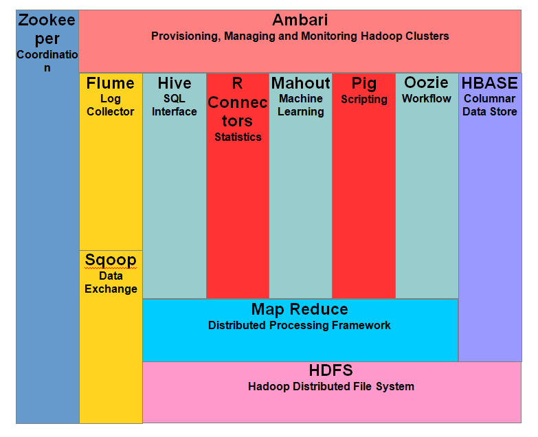
Components of Hadoop

Slide 33




Apache Hadoop Tools
Apache Hadoop: Open source Hadoop framework in Java.
Consists of Hadoop Common Package (filesystem and OS abstractions), a MapReduce engine (MapReduce or YARN), and Hadoop Distributed File System (HDFS)
Apache Mahout: Machine learning algorithms for collaborative filtering, clustering, and classification using Hadoop
Apache Hive: Data warehouse infrastructure for Hadoop. Provides data summarization, query, and analysis using a SQLlike language called HiveQL.
Stores data in an embedded Apache Derby database.
Apache Pig: Platform for creating MapReduce programs using a
high-level “Pig Latin” language. Makes MapReduce programming similar to SQL. Can be extended by user defined functions written in Java, Python, etc.

Slide 34
Apache Hadoop Tools
Apache Avro: Data serialization system.
Avro IDL is the interface description language syntax for Avro.
Apache HBase: Non-relational DBMS part of the Hadoop project. Designed for large quantities of sparse data (like BigTable). Provides a Java API for map reduce jobs to access the data. Used by Facebook.
Apache ZooKeeper: Distributed configuration service, synchronization service, and naming registry for large distributed systems like Hadoop.
Apache Cassandra: Distributed database management system.
Highly scalable.

Slide 35
Apache Hadoop Tools
Apache Ambari: A web-based tool for provision, managing and monitoring Apache Hadoop cluster
Apache Chukwa: A data collection system for managing large distributed systems
Apache Sqoop: Tool for transferring bulk data between structured databases and Hadoop
Apache Oozie: A workflow scheduler system to manage Apache Hadoop jobs

Slide 36
Analytics
Analytics: Guide decision making by discovering patterns in data using statistics, programming, and operations research.
SQL Analytics: Count, Mean, OLAP
Descriptive Analytics: Analyzing historical data to explain past success or failures.
Predictive Analytics: Forecasting using historical data.
Prescriptive Analytics: Suggest decision options. Continually update these options with new data.
Data Mining: Discovering patterns, trends, and relationships using Association rules, Clustering, Feature extraction
Simulation: Discrete Event Simulation, Monte Carlo, Agent-based
Optimization: Linear, non-Linear
Machine Learning: An algorithm technique for learning from empirical data and then using those lessons to predict future outcomes of new data

Slide 37
Analytics…
Web Analytics: Analytics of Web Accesses and Web users.
Learning Analytics: Analytics of learners (students)
Data Science: Field of data analytics

Slide 38
Summary
Big data has become possible due to low cost storage, high performance servers, high-speed networking, new analytics
Google File System, BigTable Database, and MapReduce framework sparked the development of Apache Hadoop.
Key components of Hadoop systems are HDFS, Avro data serialization system, MapReduce or YARN computation engine, Pig Latin high level programming language, Hive data warehouse, HBase database, and ZooKeeper for reliable distributed coordination.
Discovering patterns in data and using them is called Analytics. It can be descriptive, predictive, or prescriptive
Types of Databases: Relational, SQL, NoSQL, NewSQL, Key-Value Pair (KVP), Document, Columnar, Graph, and Spatial

Slide 39
Bibliography
J. Hurwitz, et al., “Big Data for Dummies,” Wiley, 2013, ISBN:978-1-118-50422-2 (Safari Book)
A. Shieh, “Sharing the Data Center Network,” NSDI 2011, http://www.usenix.org/event/nsdi11/tech/full_papers/Shieh.pdf
IBM. “What is MapReduce?,” http://www-01.ibm.com/software/data/infosphere/hadoop/mapreduce
Michael Minelli, "Big Data, Big Analytics: Emerging Business Intelligence and Analytic Trends for Today's Businesses,“ Wiley, 2013, ISBN:111814760X
S. Ghemawat, et al., "The Google File System", OSP 2003, http://research.google.com/archive/gfs.html
F. Chang, et al., "Bigtable: A Distributed Storage System for Structured Data," 2006

Slide 40
Quiz
The 3V's that define Big Data are _______________,
_______________, and _______________
ACID stands for _______________, _______________,
_______________, and _______________
BASE stands for _______________ , _______________,
_______________, and _______________ Consistency.
_______________ data is the data that has pre-set format.
Data in _______________ is the data that is streaming.

Slide 41


